Slide 1
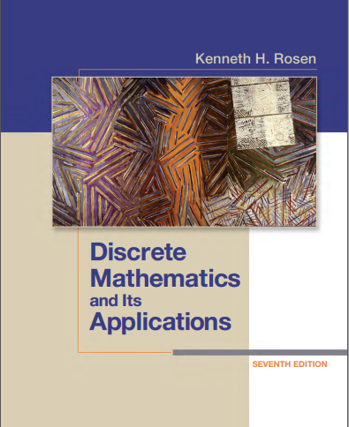

Discrete structures
By Dr. sajid iqbal
Course Reference Book

Slide 2
Learning objectives
Mathematical Reasoning
In computer science, you will encounter many mathematical concepts and ideas. You must be able to reason about them in proper way using mathematical logic and devising proofs
Combinatorial Analysis
Counting objects and forming their groups is art. In computer science, you will encounter many counting problems. Learning skills to combinatorial analysis will equip you with skill to solve such problems.
Discrete Structures:
Data in computers is usually represented as discrete data types like int. The knowledge of discrete structures allows you to interact with such things in better way when you are programming. These discrete structures include sets, relations, permutations, graphs, trees and finite state machines.

Slide 3
Learning objectives
Algorithmic Thinking:
Mathematics is the process of describing the lengthy and complex textual descriptions in short and concise way. In computer science, you are required to write algorithms which involve complex mathematical representation of the processes to be programmed. You need to know about methods and procedures used to analyze the algorithms, their correctness. In summary, you need to know about algorithmic thinking when you have to express something in the form of algorithm.
Applications and Modeling:
Discrete mathematics has applications to almost every conceivable area of study. There are many applications to computer science and data networking in this text, as well as applications to such diverse areas as chemistry, biology, linguistics, geography, business, and the Internet. Modeling with discrete mathematics is an extremely important problem-solving skill, which students have the opportunity to develop by constructing their own models in some of the exercise

Slide 4
Course Information
Information | Details | Details
Course Title | Discrete Structures
Credit Hours | 3
Course Learning outcomes:
Understand the key concepts of discrete structures like Sets, Permutations, Relations, Graphs, Trees, Dictionaries etc.
Apply formal logic proofs and or informal. Logical reasoning to real problems such as predicting the behavior of software or solving computer based problems
Apply discrete structures into other computing problems such as formal specifications, verifications, databases, artificial intelligence etc.
Differentiate different discrete structures and their relevance within the context of computer science specifically in the area of data structures and algorithms

Slide 5
Course contents
Mathematical Reasoning
Propositional and predicate logic
Rules of inference
Proofs by induction
Proofs by contraposition
Proofs by contradiction
Proofs by implication
Set theory
Relations
Equivalence relations and partitions
Partial ordering
Recurrence relations
Functions
Mappings
Functional compositions
Inverse functions
Recursive functions
Number theory
Sequences
Series
Counting
Inclusion and Exclusion Principals
Permutations and Combinations
Elements of Graph theory
Planner Graphs
Graph Coloring
Euler Graph
Hamiltonian Paths
Rooted Trees
Traversals

Slide 6



Thanks for watching
Dr. Sajid Iqbal
Assistant Professor
Department of Computer Science
Bahauddin Zakariya University, Multan
sajidiqbal.pk@gmail.com
https://github.com/sajjo79/DiscreteMathematics
Allah Hafiz
COMEDXD

